Slide 1
Agenda
Map Quiz
Impressionism
Notes
Light activity
Conservative V Liberal
Quiz
Notes
Article

Slide 2
Objectives
Understand the reason for art to adapt to impressionism.
Explain the difference between a conservative and a liberal.
Determine whether you are more liberal or conservative.

Slide 3
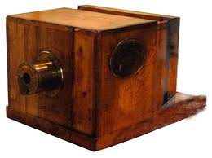
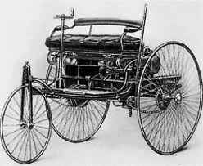
The story continues…
IR brought many new advances.
Antiseptics, telephone, light bulb, automobile, Camera

Slide 4
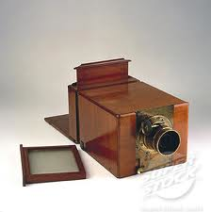
Camera
Huge impact on the art world in late 1800s
Camera better than painter
What should artists do?

Slide 5
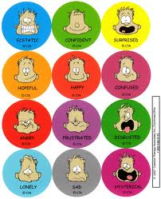
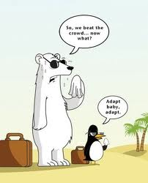
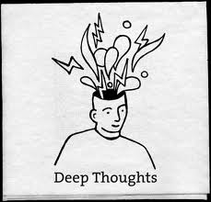
Time for change…
Artists “adapt” they start painting their impressions.
They put their thoughts and feelings in to art.

Slide 6
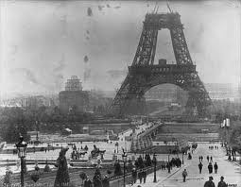
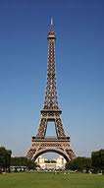
Impressionism marks beginning of modern art.
Eiffel Tower built in 1889 as 100th anniversary of French Revolution
Model for skyscrapers to come

Slide 7
Read Article

Slide 8
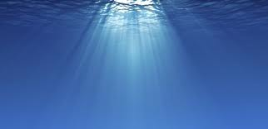
Impressionism
Artists love to use light because it made things look interesting

Slide 9
Degas

Slide 10
Madame Monet and Her Son” by Monet

Slide 12
Light Activity
Shine a flashlight on the object at a three different angles (left, right, and above
draw the shadow that you see and how it moves.
Move the light toward and away from the ball to show how the size of the shadow
Describe how the light shines on the object.

Slide 13
Read Highlight

Slide 14
Quiz
On your paper record yes or no!

Slide 15
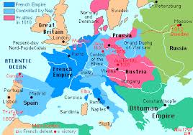
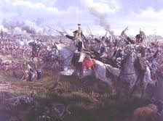
128 Conservative v Liberal
After Napoleonic Wars, leaders meet to make sure there would be lasting peace.
Didn’t want nations to be more powerful than others.

Slide 16
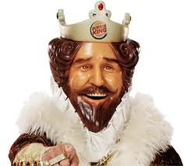
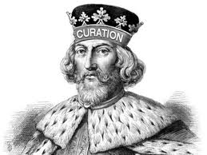
Congress of Vienna
Delegates were from aristocracy
Upper class
Wanted to go to the old way of kings

Slide 17
Conservative
Resist change and preserve traditional ways.
Society’s haves
RIGHT
Republicans

Slide 18
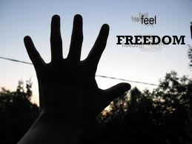
Enlightenment?
Common people still believed in the enlightenment.

Slide 19
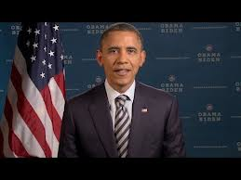
Liberals
People who support improving society.
LEFT
Have nots
Democrats

Slide 20
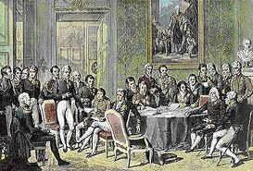
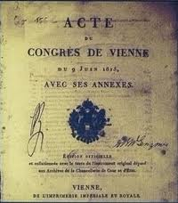
Congress of Vienna
Prevented war for a century but liberal revolts for enlightenment ideas.

Slide 21
Conservative VS Liberal
Read Article
Discuss

Slide 22
Read and highlight

