Slide 1
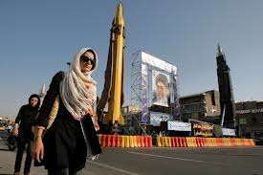
Agenda
Review Unit
Iran
Notes
Videos
Jigsaw Activity
Congressional Letter

Slide 2
Objectives
Explain the United States relationship with Iran.
Determine the policy the United States should have towards Iran.

Slide 3
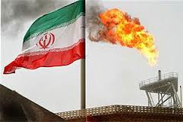
182. Iran
1951 Iran voted to nationalize its oil industry from the British.

Slide 4
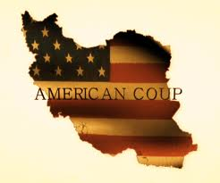
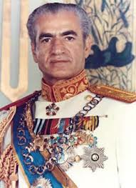
CIA
CIA secretly overthrew Iran’s democratically elected government, replaced with Shah (dictator)
CIA has done this many times, never tells Americans

Slide 5
New Iran?
For 25 years, Iran supplied U.S. with Iranian oil and a base on their land.

Slide 6
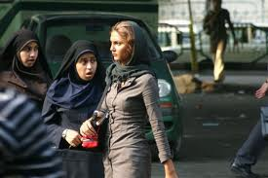
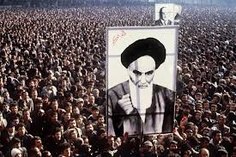
Shah?
Harsh dictator tried to westernize Iran
Iranians saw this as a threat to their Islamic culture

Slide 7
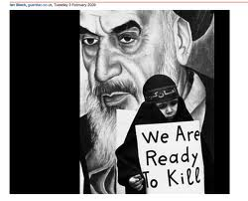
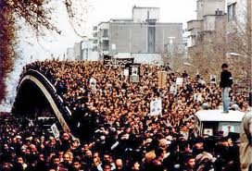
Revolution?
In 1979, Iranian revolution overthrew Shah.
Replaced with radical Muslim government that HATES U.S. government.

Slide 8
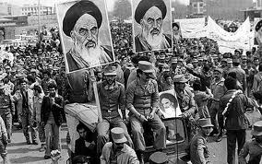
Shah in US
In US for medical treatment.
Iranians thought US would try to return him to power.

Slide 9
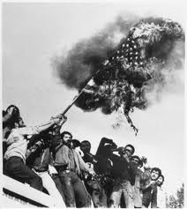
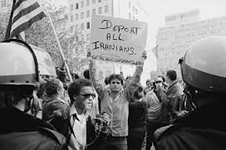
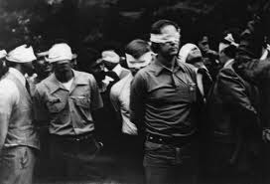
Hostages?
Young Iranians, stormed US embassy in Iran.
Took 52 hostages for over a year.

Slide 10
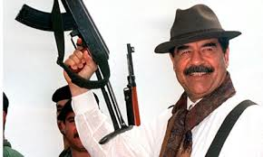
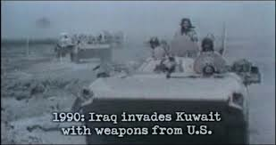
Saddam Hussein
Took advantage of hostage situation and attacked Iran.
US supported Iraq

Slide 11
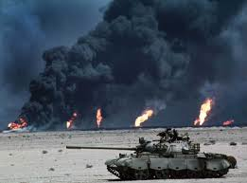
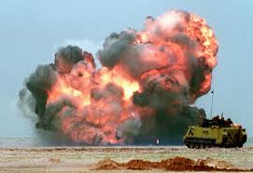
Kuwait
Ten years later Hussein invaded Kuwait.
US crushed Iraq in Persian Gulf War

Slide 12
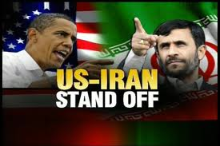
Iran and US
Have a terrible relationship.
US says Iran is making nukes.
Iran says just peaceful nuclear power plants.

Slide 13
Jigsaw Activity
There are four options the US can do with Iran.
You will be put in to groups of 3-4.
Each person is responsible for understanding their policy.
After learning about their policy we will re-form groups so there is one person in each group from each policy. Each person will teach their policy!

Slide 14
Letter to senator
Pick the policy that makes most sense to you and write your senator.
Senators: Chuck Grassley, Tom Harkin

