Slide 1
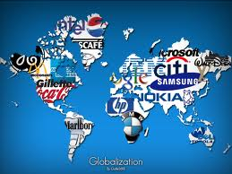
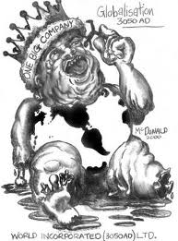
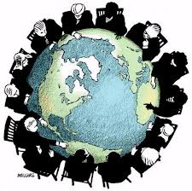
Agenda
Review
174. China
Notes
175. globalism
Reading
Play

Slide 2
Locations
Israel
Tunesia
Palestine
Egypt
Guatemala
Iran
Iraq
Kuwait
Sudan
Serbia

Slide 4
Objectives
Explain how China has changed throughout history.
Understand the debate behind globalism.

Slide 5
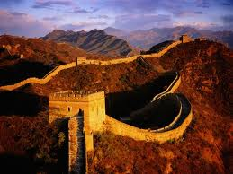
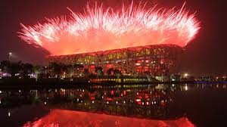
Prior Knowledge
When you hear or see the word China what do you think about?

Slide 6
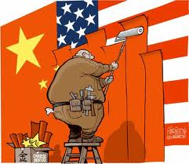
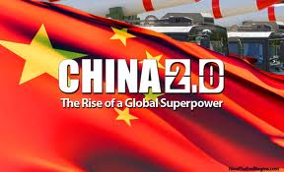
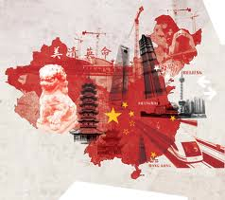
174. China
China is again a superpower. (1400s w/ Zheng He)

Slide 8
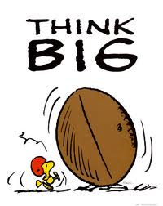
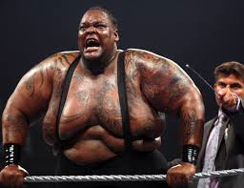
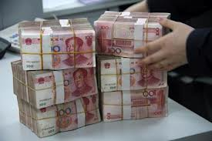
BIG
World’s largest population, labor force, and consumer markets.
Economy has boomed since capitalist reforms in the 80s.

Slide 9
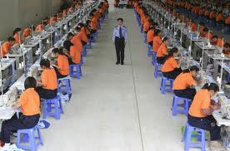
The good, the Bad, and the Ugly
China’s one-party communist government continues to deny human rights.

Slide 10
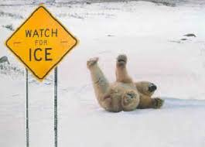
Friction
There has always been friction between China and USA.
Taiwan
Political systems
Imperialism

Slide 13
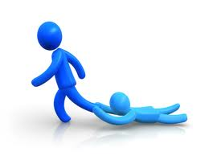
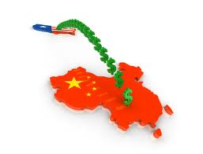
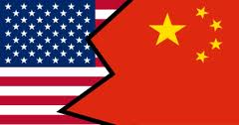
Dependent
Although distain, China and USA are linked.

Slide 14
Trade imbalance?

Slide 17
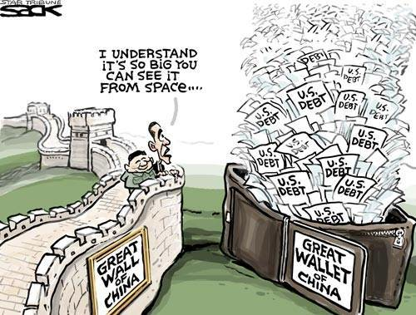
Problems?
Billions of US government debt is owned by China.

Slide 18
Notes:
China 1.2 trillion japan 959 billion

Slide 19
Friend?
US’s Biggest trading partner

Slide 20
Foe?
China’s military and economy grow.
US and China compete for natural resources

Slide 21
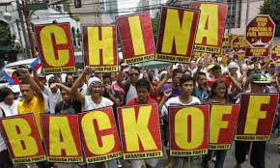
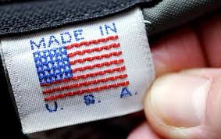
Take That China
China

Slide 22
Read it…

Slide 23
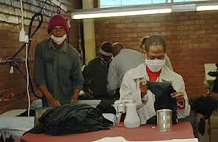
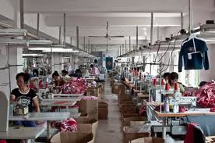
Who made your shirt?

Slide 24
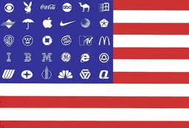
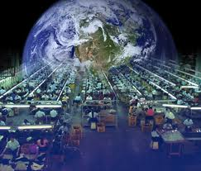
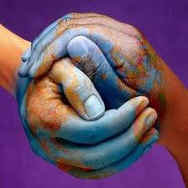
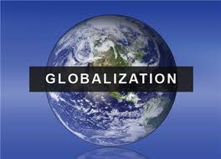
175. Globalism
Reading
Questions

Slide 25
Play
Worksheet

Slide 26
Read it up now ya…

