Slide 1
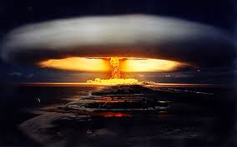
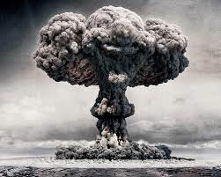
Agenda
Timeline Review
Proxy Wars
Notes
Nuclear Arms Race (Intro)
13 Days
Quiz next Class

Slide 2
Objectives
Explain how the United States and the Soviet Union got around fighting a war.

Slide 3
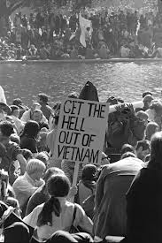
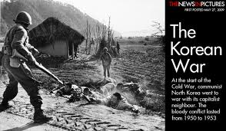
Proxy Wars
Soviet Union and U.S. never fought directly.
Korea and Vietnam were substitutes or “proxies”

Slide 4
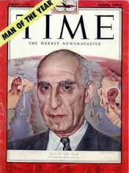
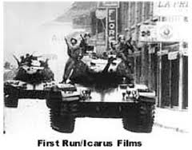
America: fought communism at all costs
Sometimes supported dictators

Slide 5
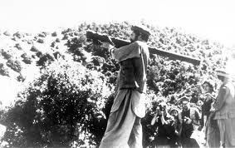
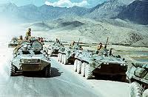
Soviet’s Vietnam
Soviet Union went to war with Afghanistan

Slide 6
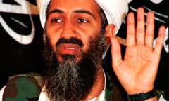
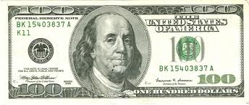
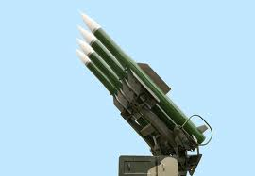
What did the U.S. do?
A. Boycott the 1980 Olympics in protest
B. Provide Osama Bin Laden money and weapons to fight Russians.
C. Provide billions of dollars to Afghans to help them defend themselves.
D. Send shoulder-fired antiaircraft missiles to help guerrilla war tactics

Slide 7
What did the U.S. do?
A. Boycott the 1980 Olympics in protest
B. Provide Osama Bin Laden money and weapons to fight Russians.
C. Provide billions of dollars to Afghans to help them defend themselves.
D. Send shoulder-fired antiaircraft missiles to help guerrilla war tactics
E. ALL OF THE ABOVE

Slide 8
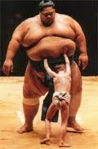
Soviet’s Vietnam?
Poor country defeated superpower USSR

Slide 9
Read it up now yah…

Slide 10
Arms Race

Slide 11
13 Days

