Slide 1
Agenda
Quiz
Review Fascism & Mass Culture
152. Totalitarian Government
Venn Diagram
Read It!
Modern Day Totalitarian Government
Stalin Video
Notes:
Will need to pass out What is Totalitarianism? Located in Primary Source folder.

Slide 2
Anticipatory Set
"Many forms of government have been tried, and will be tried in this world of sin and woe. No one pretends that democracy is perfect or all wise. Indeed, it has been said that democracy is the worst form of government except all those other forms that have been tried from time to time.”
–Winston Churchill
What does this mean?

Slide 3
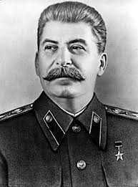
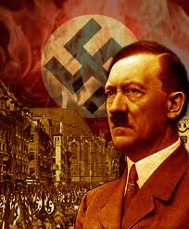
Stalin and Hitler
What is unique about these speakers?
What things are similar?
What are different?

Slide 4
Objectives
Explain how Communism and Fascism can both be totalitarian governments, yet completely different politically.

Slide 5
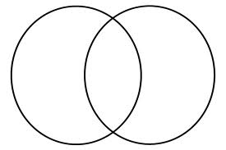
Stalin Hitler

Slide 6
A modern-day totalitarian government
North Korea video: A state of mind

