Slide 1
Agenda
Quiz
Horatio Nelson
Notes
Horrible Histories
Haiti
Notes
Cannon Ball
Assignment

Slide 2
What does it mean to be a good leader?
What characteristics make a good leader?

Slide 3
Objective
Understand the importance of Horatio Nelson.
Explain how the Haitian Revolution impacted the world’s history.

Slide 4
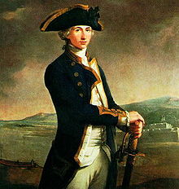
117. Horatio Nelson
England was the only major European country not conquered by Napoleon
Largely because of Admiral Nelson

Slide 5
A Most Uncommon Hero
Injuries from sea battles:
-Lost sight in one eye
-Missing one arm
Huge naval victories at the Nile,
Copenhagen, and Trafalgar
But never got over his seasickness

Slide 6
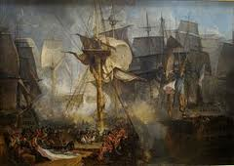
The Battle of Trafalgar
Nelson’s greatest victory, and his last
Wrecks Napoleon’s plans to invade England

Slide 7
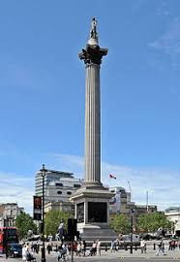
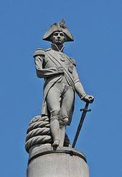
British Domination
Defeat of Napoleon meant that Britain ruled the waves.
Nelson’s column in
London’s Trafalgar Square

Slide 8
118. Haiti

Slide 9
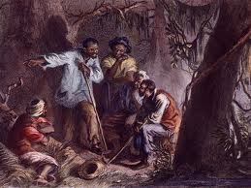
Slave Rebellion in Haiti
France’s richest colony
A brutal slave economy
Second nation in the America’s to win its independence (after the U.S)
First slave nation to gain freedom

Slide 10
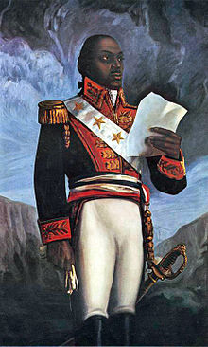
Led by Toussaint L’ Overture
A slave who learned to read
Learned of the Enlightenment
Revolutions in America and
France were his guide.

Slide 11
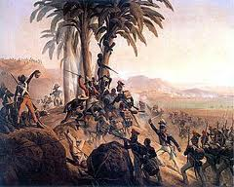
The Revolution in Haiti
Napoleon needs cash
Wants to reinstate slavery in Haiti
Sends the army to do so

Slide 12
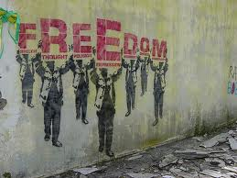
L’Oveture
Defeats French and British military to maintain freedom
Later captured by Napoleon’s forces and killed.
Freedom
Isn’t free

Slide 13
Haitian revolt
Worries slave owners everywhere
But is a symbol of hope to slaves

Slide 14
Cannon Ball

Slide 15
Key Points topic 118
Highlight

Slide 16
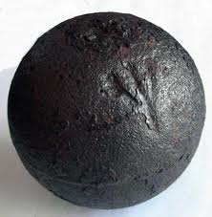
Assignment
Use the Haitian Revolution as the setting of your story and write the story behind my cannon ball.
One page minimum hand written

