Slide 1
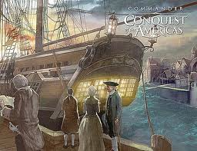
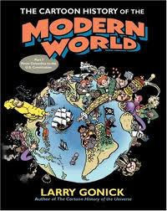
Agenda
Christopher Columbus Video
Discuss
Columbus Article
Map Locations
Key Points, Why Important?
The Modern World
Conquest of the Americas

Slide 2
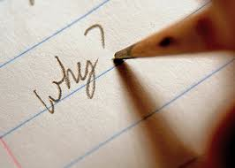
Objectives
Discuss the importance of Christopher Columbus
Understand how to write key points and Why important?
Determine the impact of European powers on the world’s history.

Slide 3
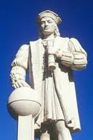
What do you think of when you hear Christopher Columbus?

Slide 4
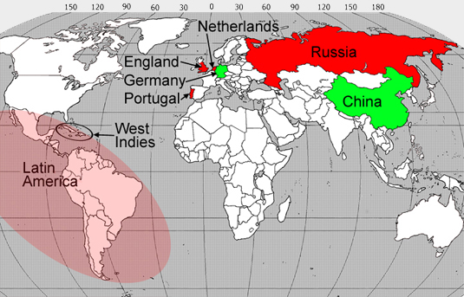

Slide 5
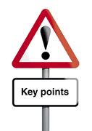
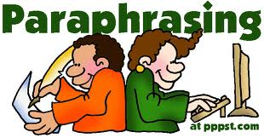
The Modern World
Read, Key Points Why Important?
Paraphrase.
Write sentence

Slide 6
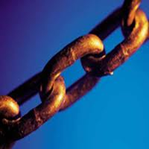
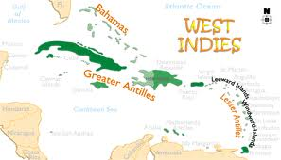
Conquest of America
Christopher Columbus arrives in the West Indies
Sets in motion a chain of events that changes the world

Slide 7
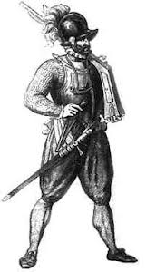
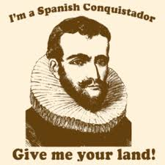
Conquistadors
Spanish explorers in search of gold and glory
Europeans start taking over the world
Gold and silver found taken from the Americas would make Spain and Portugal powerful

Slide 8
Review
Who can describe Christopher Columbus?
How do we take notes in this class? (Key Points, Why Important?)
What impact did European Powers have on the world’s history?

Slide 9
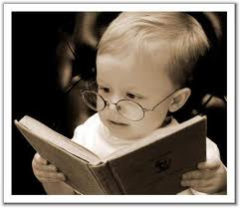
Homework
Study Map locations
Quiz next class

