Slide 1
World History: 1500-Present
Fall 2012

Slide 2
Agenda
Objectives
Welcome PowerPoint
Class Instructions
Pre-Test
Textbook
History Activity

Slide 3
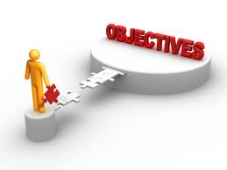
Objectives
Understand Mr. Allen’s rules and expectations of World History
Describe what history is and how it is written.

Slide 4
Welcome
VERY EXCITED TO BE BACK AT SCHOOL!!
Short Video

Slide 5
Requirements:
Respect
Class Participation
Materials
Homework
Test and Quizzes

Slide 6
You will like Mr. Allen if….
You come to class on time
You participate in class discussion
You have a positive attitude
You keep an open mind
If you put forth effort!!

Slide 7
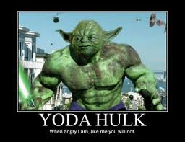
You will hate Mr. Allen if…
You are not teachable
You have a bad attitude
You know it all already
You are late
If you do not try

Slide 8
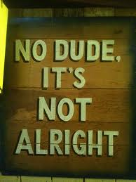
IMPORTANT REMINDER!!!!
I AM NOT YOUR FRIEND
I AM NOT DUDE
I AM NOT YOUR BRO, BRA, BROTHER, or anything of the like
I AM YOUR TEACHER.

Slide 9
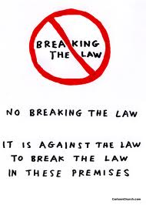
REMINDER CONTINUED
If you talk about doing illegal things I will report you
Why?

Slide 10
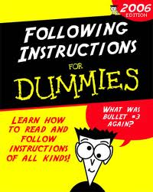
Handout Class Instructions

Slide 11
Hand out Textbook
Discuss

Slide 12
Activity
Pair up
Each person must write answers to the questions

Slide 13
Activity
Imagine that you are the principal of a school and you just found out that there was a fight in the lunchroom during lunch. You’ve asked many students and teachers who witnessed the fight to write down what they saw and who they think started the fight. Unfortunately, you have received many conflicting accounts that disagree not only as to who started the fight, but also as to who was involved and when the fight even started. It’s important to remember that NO ONE is just plain lying.

Slide 14
Answer the Following
Why would there be different stories of the event if no one is just plain lying?
What are the different types of people who might have seen this fight?
What might make one person’s story more believable or plausible than another person’s?

Slide 15
Debrief/Things to discuss
Why might people see or remember things differently?
Who has an interest in one kid getting in trouble instead of another kid? Who was standing where? Could they see the whole event?
The plausibility of the stories themselves (e.g., issues of exaggeration and how the stories fit into what is known about the students’ prior histories). Is the story believable, trustworthy?

Slide 16
Debrief Continued
Time: Do stories change over time? How might what we remember right after the event differ from what we remember a week later? Does time make the way someone remembers something more or less trustworthy?
Physical Evidence: what kinds might have an effect on what you believe: bruises, missing objects, etc.

Slide 17
What is History?
All of these things apply to history: How events are interpreted, remembered, explained, and judged to be trustworthy. Studying history involves considering people’s perspectives and biases; evidence; trustworthiness. Similar to the principal, historians trying to figure out what happened in the past.

