Slide 1
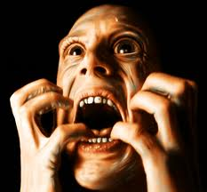
Agenda
Turn in Essay
Introduce LAST unit!
Map locations
New World Order

Slide 2
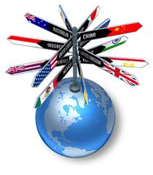
Overview
Overview: At the beginning of this century, the Cold War was over and America was the only superpower. The old threat of communism was being replaced by new threats including terrorism and global warming. The nations of the world are now more closely linked than ever before by communication technologies and commerce, yet many people in the world are still struggling to find enough food to stay alive. Meanwhile, the U.S. has damaged its reputation in the world by invading the Middle Eastern nation of Iraq, and China is fast becoming the world’s newest superpower.

Slide 3
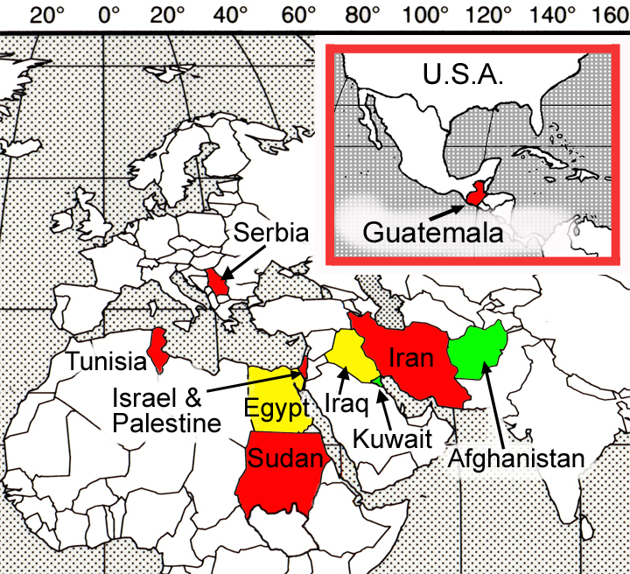

Slide 4
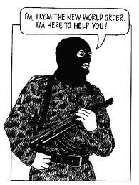
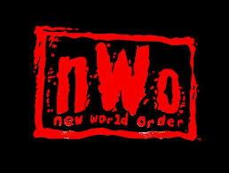
173. New World Order
20th Century Cold War is over!
Capitalism won.

Slide 5
Lone Wolf?
America lone super power left standing.

Slide 6
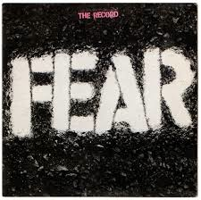
Cold War fears REPLACED
What things are we afraid of in the 21st Century?
Global Warming
Terrorism
Nuclear weapons
West losing the dominance they have had since the age of imperialism.
All of the above

Slide 7
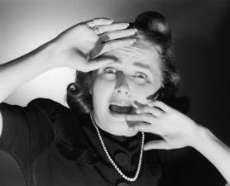

Slide 8
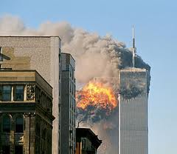
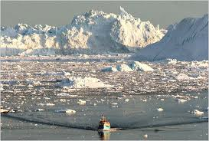
Cold War fears REPLACED
What things are we afraid of in the 21st Century?
Global Warming
Terrorism
Nuclear weapons
West losing the dominance they have had since the age of imperialism.
All of the above

Slide 9
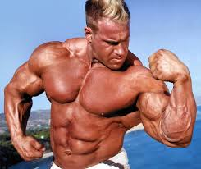
Looking east
When looking east, west used to see colonies.
Today:
Japan
China
India
Notes:
The economy of Japan is the third largest in the world by nominal GDP and fourth largest by Purchasing power parity
China second highest
India 3rd
Japan 4th

Slide 10
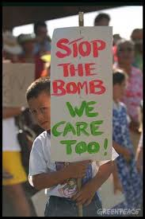
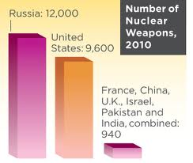
Nuclear Weapons Fear
Still here
US will not give up large arsenal, yet tells other nations they cannot have nuclear weapons.

Slide 11
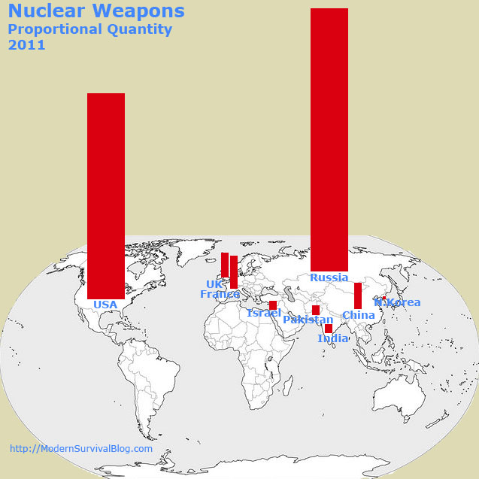

Slide 12
North Korea? Iran?

Slide 13
US a hypocrite?
No objections to allies getting nukes.

Slide 14
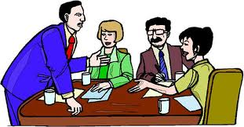
Deliberation

Slide 15
Option 1
Eliminate Nuclear Weapons NOW

Slide 16
Option 2
Rely on Arms Control

Slide 17
Option 3
Keep nuclear weapons as an essential part of US Security

Slide 18
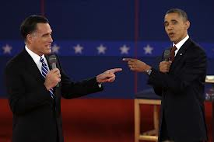
Debate
What is the best policy the US should adopt?
And why?

