Slide 1
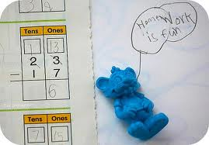
Agenda
Review Nanking Massacre/
Spanish Civil War
Appeasement
Notes
Debate
Homework!
Quiz

Slide 2
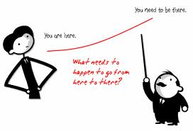
Objectives
Explain the policy of appeasement.
Determine whether appeasement is a good policy or not.

Slide 3
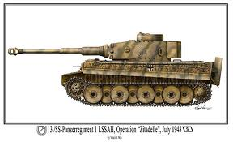
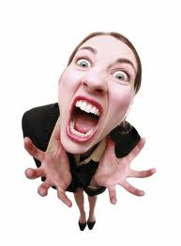
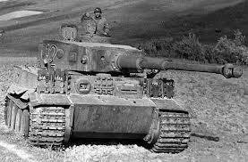
155. Appeasement
Germans upset about Treaty of Versailles
Hitler rebuilds German army

Slide 4
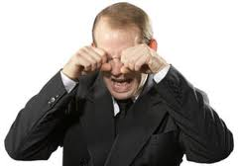
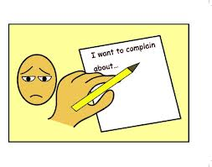
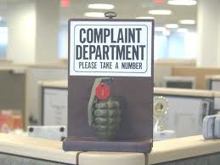
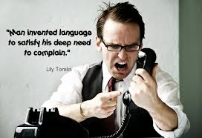
Response
Britain and France complain but do nothing

Slide 5
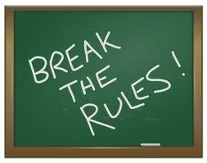
Germany
In 1936 Hitler sends troops in to Rhineland (near France)
Then brings Germany and Austria together
Conquers Czechoslovakia

Slide 6
ALL FORBIDDEN BY THE TREATY OF VERSAILLES

Slide 7
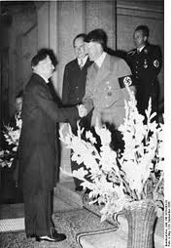
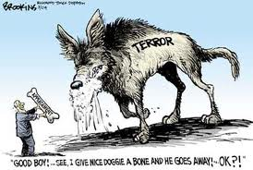
Britain and France
Following APPEASEMENT
Which means giving in to Hitler’s demands to avoid conflict and another war

Slide 8
Opinions- Half time break
Notes:
The lesson sequence went like this:
1. (5 mins) Setting the Scene
a. Rant a bit about how pupils have opinions in so many things - e.g. Tony Blair, Iraq, politicians, Britney Spears - when actually they know virtually NOTHING about what they are talking about. Such opinions are really prejudices, not opinions. If they are going to form proper opinions, they should form them by properly examining the evidence. (This is important, because it makes them draw their ideas from the materials you are giving them.)
b. Divide the class into two groups, and give out the Judgements on Appeasement factsheets. Explain that these statements are all culled from the internet about appeasement, and so they will be able to read them and come to a properly-formed opinion.
c. What the pupils DON'T know is that, in fact, there are TWO different factsheets. One has an overwhelming balance of statements IN FAVOUR of appeasement, the other is hugely biased AGAINST appeasement. The two worksheets LOOK identical, but give copies of one out to one group, copies of the other out to the second group.
2. (10 mins) Give the pupils some reading time.
3. (10 mins) Pair Work
Tell the pupils, working with a partner (within their larger group), to go through the statements, deciding whether they are FOR or AGAINST appeasement, and whether they think that particular statement is a STRONG or a WEAK argument.
4. (10 mins) Group decision
a. Appoint a convener for each group, and get them - using the ideas they have formed from their reading and pair work - to discuss as a group what they think of appeasement.
b. After about 10 minutes, ask the pupils to indicate by a show of hands who has decided for, and who is against appeasement. Given the biased documentatiomn supplied, here should be overwhelming support within the groups for or against appeasement. You can either tell the isolates that they have to change and work with their group, or move them into the other group. Remember, if you move them, to unobtrusively make them leave also their factsheets, so that the pupils might not click that they are being manipulated.
5. (10 mins) Preparation for the Debate
a. Tell the two opposing groups that you are about to arrange an open debate between the two sides. The initial statements will be made by an 'Any Questions' style set-up, with two people from each side making opening statements, but that then you will open up the debate to statements and questions from other people.
b. The side you adjudge to be the winner will get off any homework; the side you adjudge to be the loser will have to do extra homework (obviously they need it), making notes on the factsheets.
c. Set the preparation tasks, therefore, of:
- selecting their two representatives and helping them work out an opening speech which will be hard-hitting and 'make the case'.
- letting them practise making the speech, with a 'coach' to help them deliver it better.
- work out obvious 'help you' questions to ask their own representatives during the wider debate.
- work out hard unaswerable questions to ask the representatives of the other side.
6. (up to 15 mins) Debate
a. Set up the 'Any Questions' table,
b. Start the debate, with the opening statements from the two teams.
c. Throw the debate open to other statements and questions, and sit back and enjoy the sparks! From time to time, draw in pupils who might be happy to sit back and let others do all the talking.
d. At the end, declare the debate a draw and let everybody off their homework!
I hope it works as well for you as it did in my lesson.

Slide 9
R.B. Rebecca Black

Slide 10
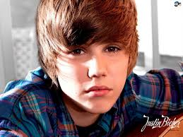
Justin Bieber

Slide 11
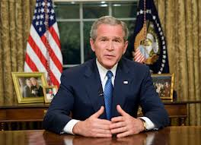
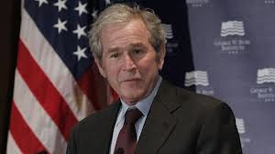
President Bush

Slide 12
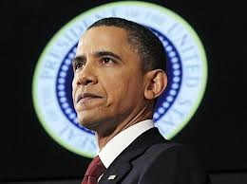
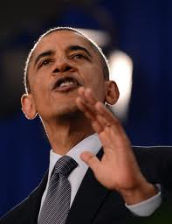
President Obama

Slide 13
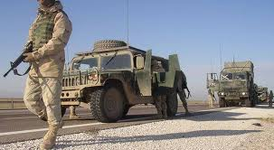
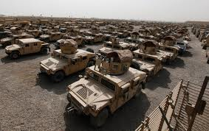
War in Iraq

Slide 14
Rant
Notes:
1. (5 mins) Setting the Scene
a. Rant a bit about how pupils have opinions in so many things - e.g. Tony Blair, Iraq, politicians, Britney Spears - when actually they know virtually NOTHING about what they are talking about. Such opinions are really prejudices, not opinions. If they are going to form proper opinions, they should form them by properly examining the evidence. (This is important, because it makes them draw their ideas from the materials you are giving them.)

Slide 15
Debate
Appeasement good or bad?
Winning team will not have to do the homework.

Slide 16
Read the arguments on Appeasement
Notes:
2. (10 mins) Give the pupils some reading time.

Slide 17
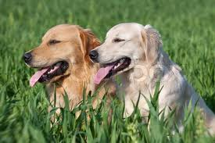
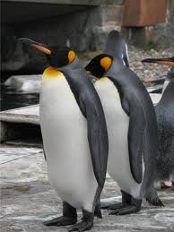
Pair up
Notes:
3. (10 mins) Pair Work
Tell the pupils, working with a partner (within their larger group), to go through the statements, deciding whether they are FOR or AGAINST appeasement, and whether they think that particular statement is a STRONG or a WEAK argument.

Slide 18
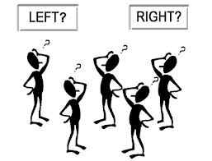
Group Decision
Notes:
4. (10 mins) Group decision
a. Appoint a convener for each group, and get them - using the ideas they have formed from their reading and pair work - to discuss as a group what they think of appeasement.
b. After about 10 minutes, ask the pupils to indicate by a show of hands who has decided for, and who is against appeasement. Given the biased documentatiomn supplied, here should be overwhelming support within the groups for or against appeasement. You can either tell the isolates that they have to change and work with their group, or move them into the other group. Remember, if you move them, to unobtrusively make them leave also their factsheets, so that the pupils might not click that they are being manipulated.

Slide 19
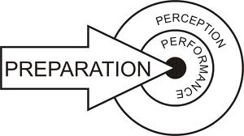
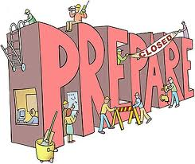
Prepare for debate
Opening statement
Make questions
Notes:
5. (10 mins) Preparation for the Debate
a. Tell the two opposing groups that you are about to arrange an open debate between the two sides. The initial statements will be made by an 'Any Questions' style set-up, with two people from each side making opening statements, but that then you will open up the debate to statements and questions from other people.
b. The side you adjudge to be the winner will get off any homework; the side you adjudge to be the loser will have to do extra homework (obviously they need it), making notes on the factsheets.
c. Set the preparation tasks, therefore, of:
- selecting their two representatives and helping them work out an opening speech which will be hard-hitting and 'make the case'.
- letting them practise making the speech, with a 'coach' to help them deliver it better.
- work out obvious 'help you' questions to ask their own representatives during the wider debate.
- work out hard unaswerable questions to ask the representatives of the other side.

Slide 20
Debate
Notes:
6. (up to 15 mins) Debate
a. Set up the 'Any Questions' table,
b. Start the debate, with the opening statements from the two teams.
c. Throw the debate open to other statements and questions, and sit back and enjoy the sparks! From time to time, draw in pupils who might be happy to sit back and let others do all the talking.
d. At the end, declare the debate a draw and let everybody off their homework!

Slide 21
Winner
Notes:
d. At the end, declare the debate a draw and let everybody off their homework!

Slide 22
Read Appeasement

